Slide 1

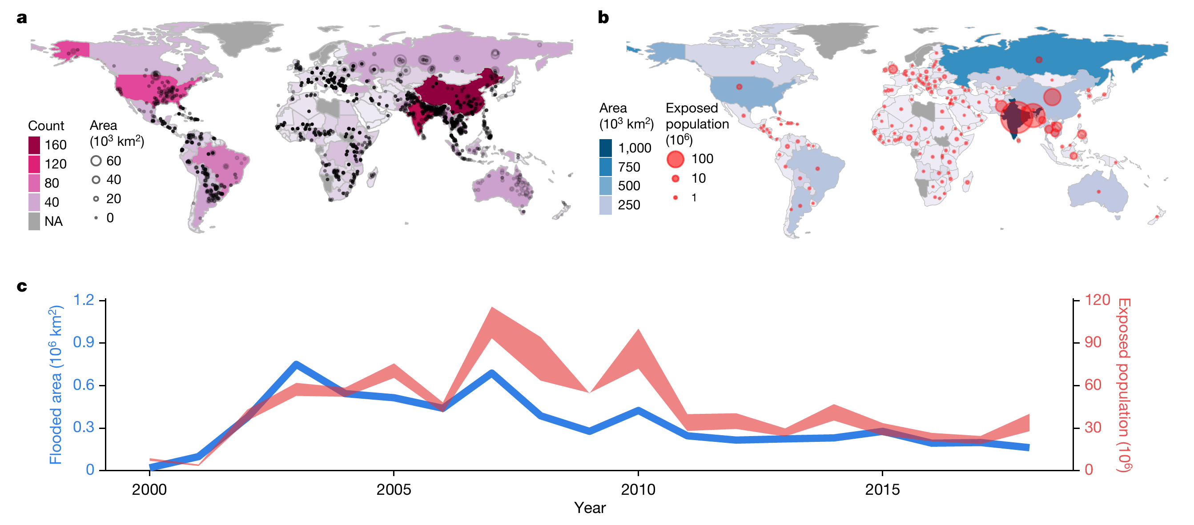
Machine Learning - Based Technologies for Enhancing Urban Resilience
*Nie Yanfeng *Gong Yulin *Zuo Hang
*Cheng Qian *Jiang Sihang *Li Lingjieling *Yang Mohan
基于机器学习和深度学习的提升城市韧性的技术

Slide 2
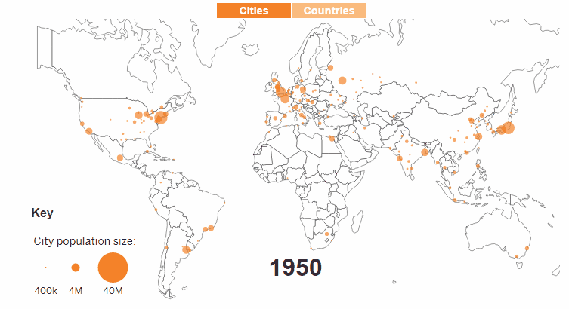
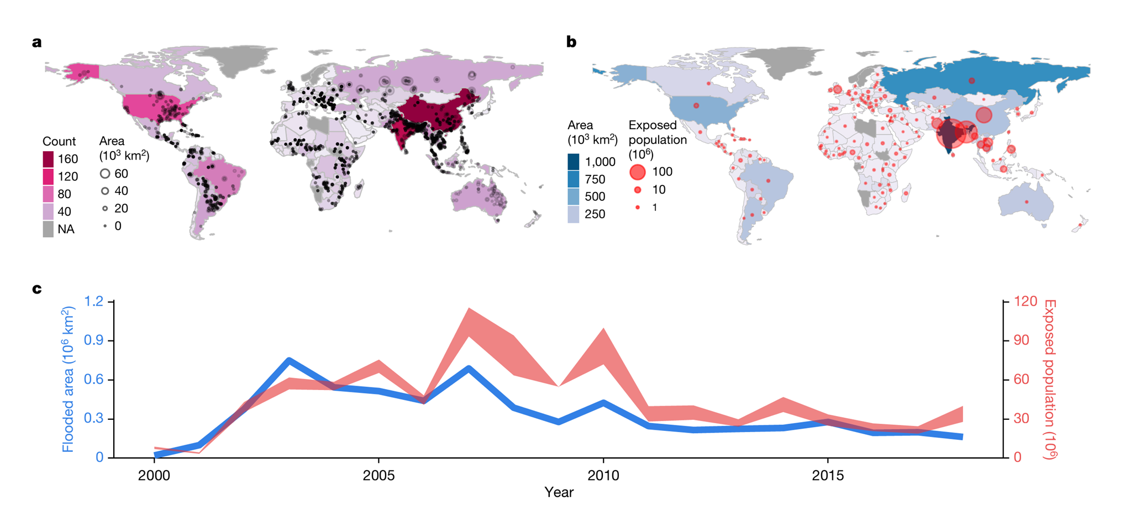
Is It Really Better? Dual Aspect of Urbanization! 城市化一定是好的吗？
1) Growing Population Intensity
2) Higher Frequency Of Disasters
The 20th National Congress of the Communist Party of China informed the more habitable, resilient and intelligent cities are ought to be designed and developed nationwide in China.

Slide 3
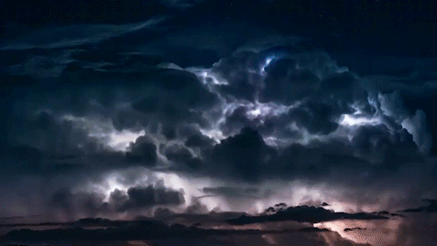

How Should We Do? Let’s Have A Simulation! 让我们从一次毁灭性的台风谈起！
The time axis started at when a severe typhoon of category 15, named as Haishen, landed on the coastline of Raccoon city.
剧情概要： 一场灾难性的15级的超强台风“海神”将要在沿海城市“浣熊市”登陆……
Formed Date: May 20th, 2023 Status: Super typhoon status
Wind Speed: 68 meters per second
Minimum Central Pressure: 905 hPa

Slide 4
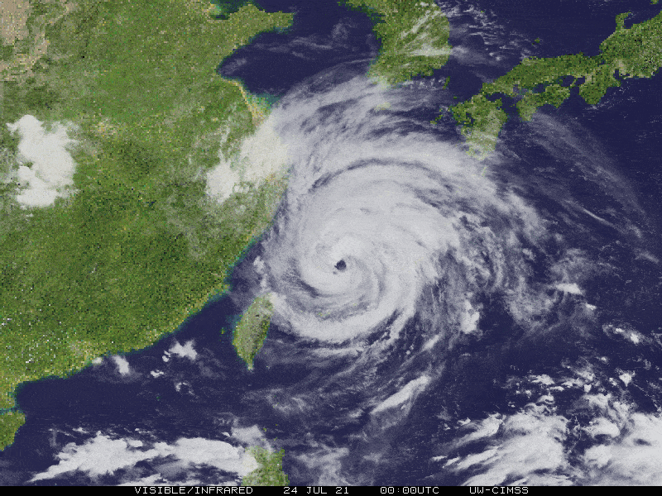
Story Line:
Before Disaster
During Disaster
After Disaster
State 1: Far Away On The Pacific Ocean
阶段一 登陆之前：暴风雨前的宁静与紧张
The Raccoon City
1) On May 24th, Pangu Weather simulated and updated data in second-level, providing a prediction of trace 5 days before Haishen landed.
2) Forecast Information was sent to the government and other relevant departments. On May 25th, the government made emergency measures, noticing the public.
3) People started to take actions. On May 25th, some factories were shut down, buildings were secured, all windows were closed, and people stored enough food.

Slide 5
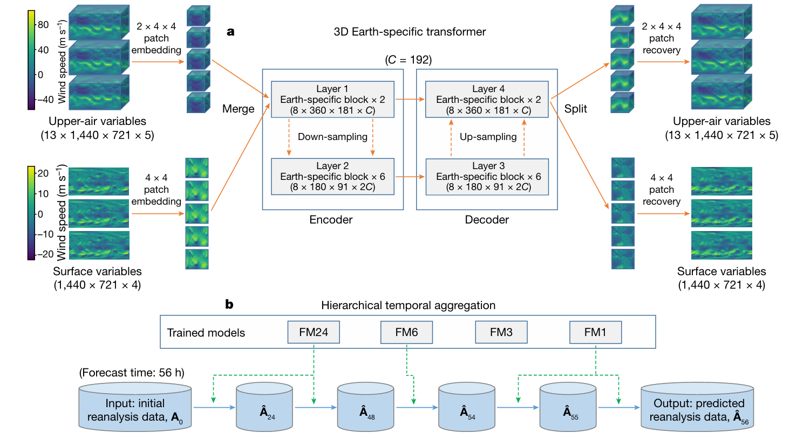
Question 1: How could the prediction be more precise and rapid?
盘古大模型如何做到又快又准？
1) 3D Earth-specific transformer (3DEST)
分析地表的三维神经网络,比过去的二维地表更全面

Slide 6
Question 1: How could the prediction be more precise and rapid?
盘古大模型如何做到又快又准？
2) Hierarchical Temporal Aggregation strategy 按时间分割的贪心算法，每一步取最优解

Slide 7
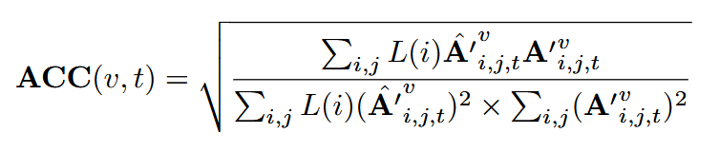
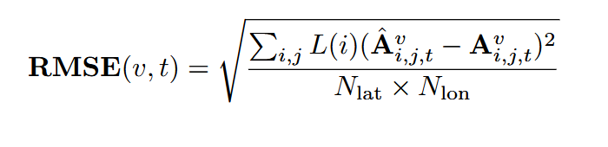
Question 1: How could the prediction be more precise and rapid?
盘古大模型如何做到又快又准？
3) Two evaluation metrics 评估模型性能的度量以及训练效果
模型精度
均方根误差

Slide 8
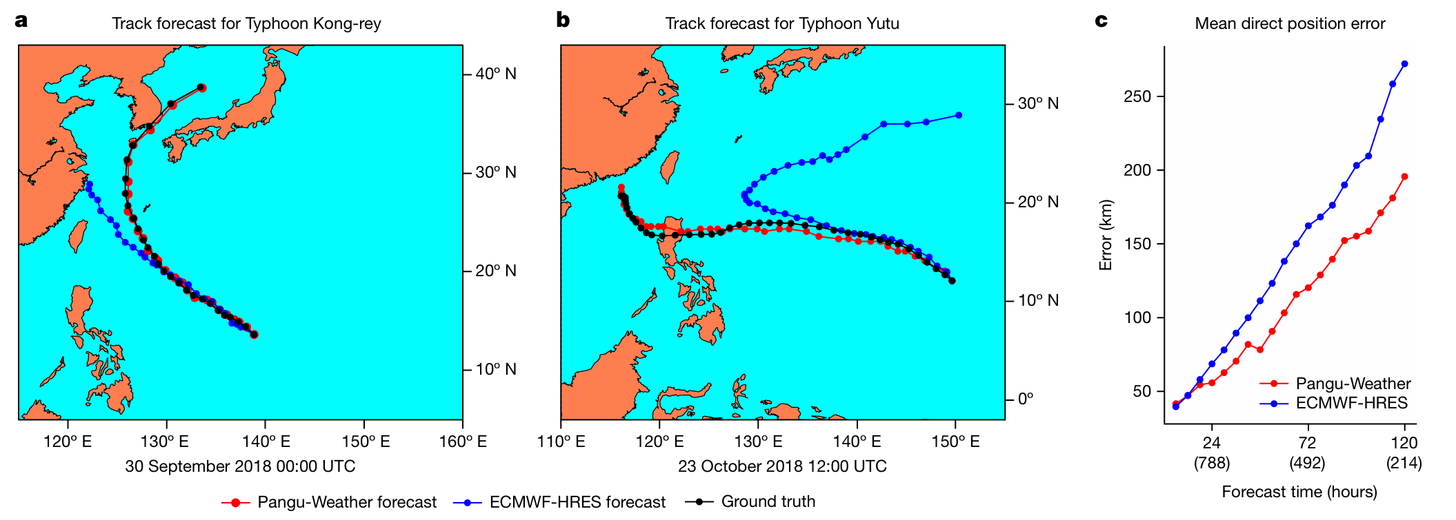
Question 1: How could the prediction be more precise and rapid?
盘古大模型如何做到又快又准？
3) Two evaluation metrics 评估模型性能的度量以及训练效果

Slide 9
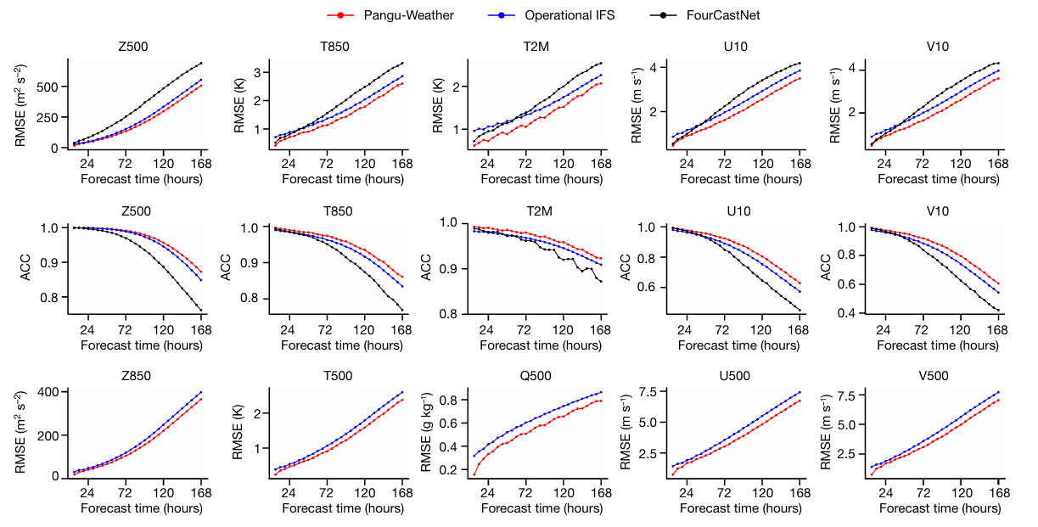
Question 1: How could the prediction be more precise and rapid?
盘古大模型如何做到又快又准？
3) Two evaluation metrics 评估模型性能的度量以及训练效果
The operational IPS 当下流行的传统数值预测系统
FourCastNet 训练速度极快的人工神经网络， 但准确度较低

Slide 10
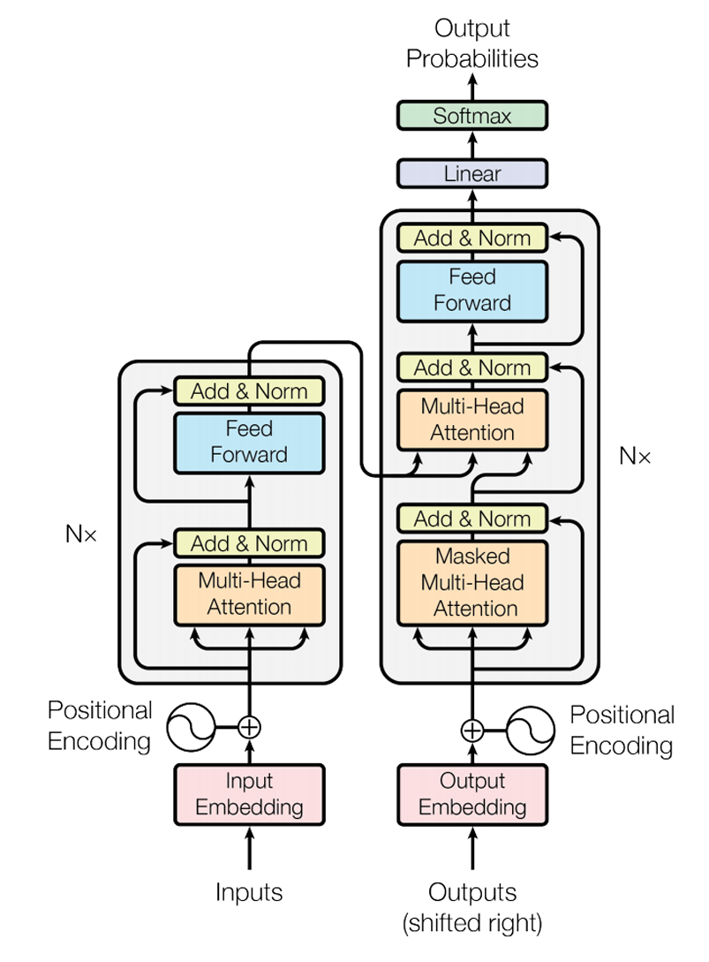
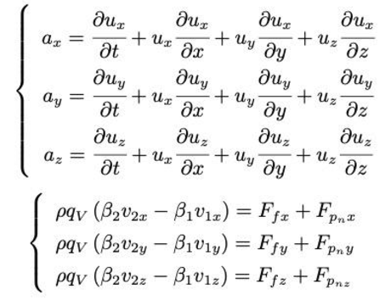
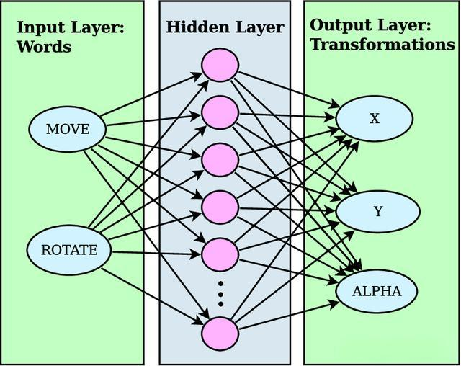
Question 2: How did the new model built?
盘古大模型背后的底层原理是什么？
1) Battle between algorithms of past and now
传统的物理学公式与新型神经网络之间的较量
2) Multi-Head Attention and Positional Encoding
让神经网络产生“记忆力”和“注意力”

Slide 11
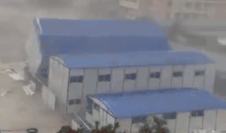
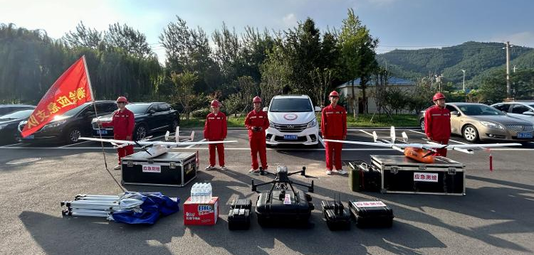
Story Line:
Before Disaster
During Disaster
After Disaster
State 2: Sweeping Over The Whole City
阶段二 天灾降临：力量之间的对抗
1) When the typhoon was approaching, strong winds and heavy precipitation begun to pose a threat to the city. At this point, our remote sensing technology came into play.
2) By means of UAV remote sensing technology, we carried out urban typhoon emergency mapping and compiled a disaster damage database, evacuating the public in a timely manner before the danger occurred.
3) As for the citizens who unfortunately suffered from the disaster due to not being evacuated in time, we dispatched multifunctional biomimetic robots to conduct rescue operations.

Slide 12
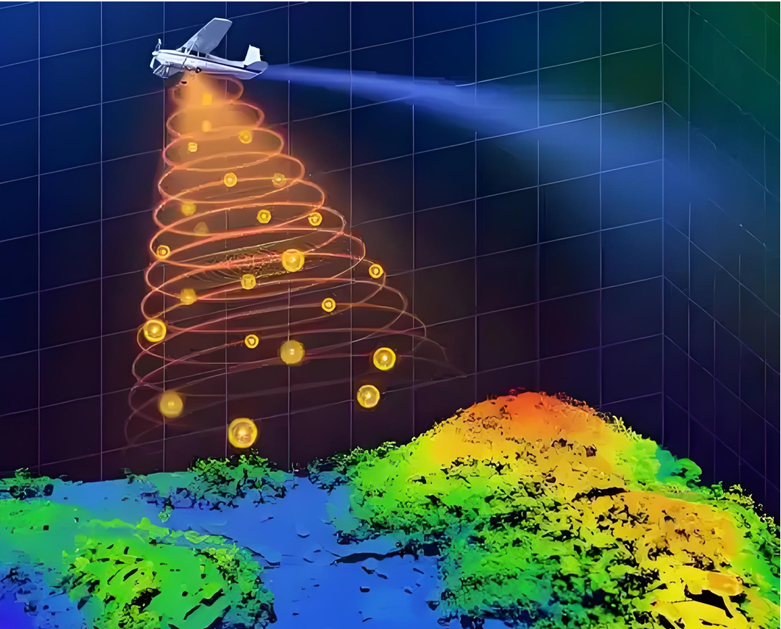
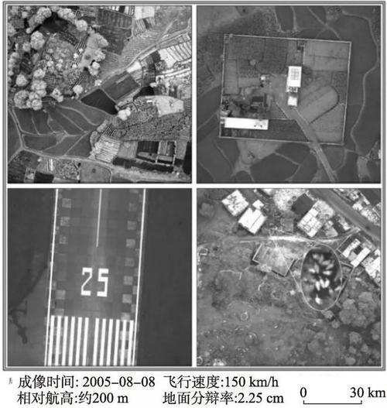
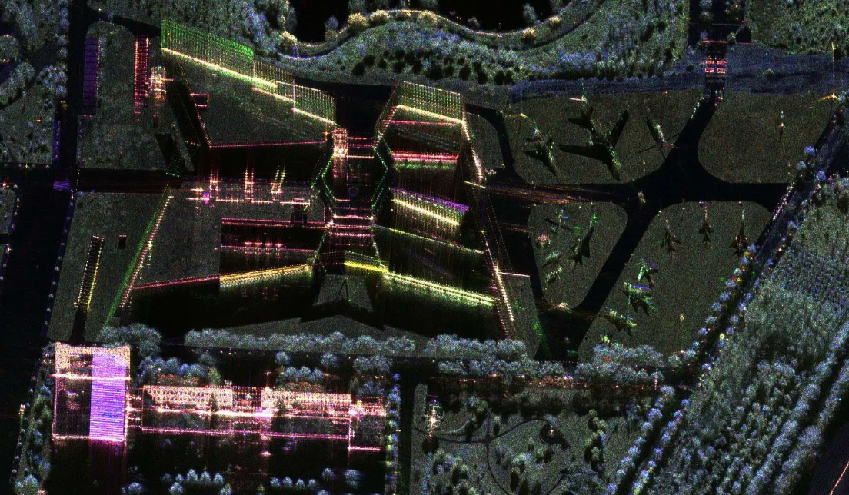
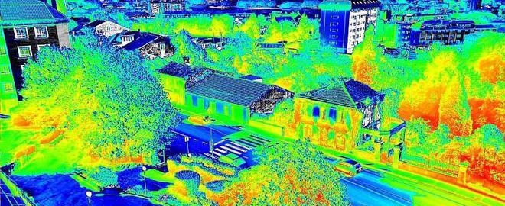
Question: How to create mapping & database?
高精度遥感地图和数据库是如何建立的？
2) Data processing
1) Data acquisition
3) Image analysis
high-definition thermal imager 借助红外热成像仪构建三维场景
high-resolution camera 厘米级高分辨率正射影像
PolSAR images & GLCM 配合机器学习识别可能倒塌的房屋

Slide 13
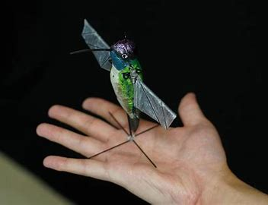
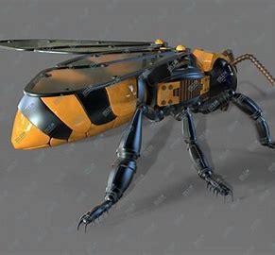
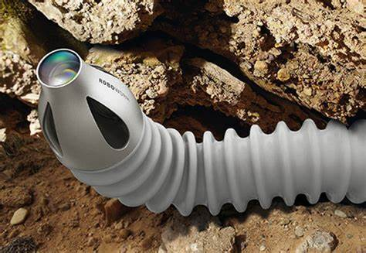
Story Line:
Before Disaster
During Disaster
After Disaster
State 3: Leaving Rain, Relieving Heart
阶段三 劫难过后：协力奋战，曙光初见
1) Aerial robots and Snake robots be dispatched, navigating through the debris of collapsed buildings in search of signs of survivors.
2) Once survivors are found, it's time for the legged robots to shine. They nimbly traverse the ruins, carrying survivors out of danger or transporting supplies to support post-disaster reconstruction.
Aerial Robots
Snake Robots
3) These robots are not lone heroes but operate in swarms, as shown here, relying on an integrated space-earth robot swarm that shares information to greatly enhance the efficiency of disaster relief.

Slide 14
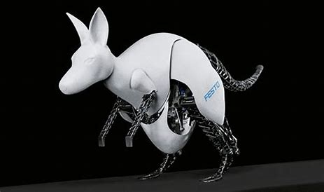
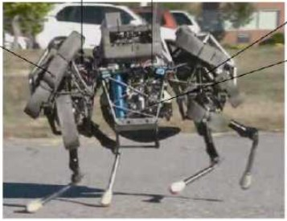
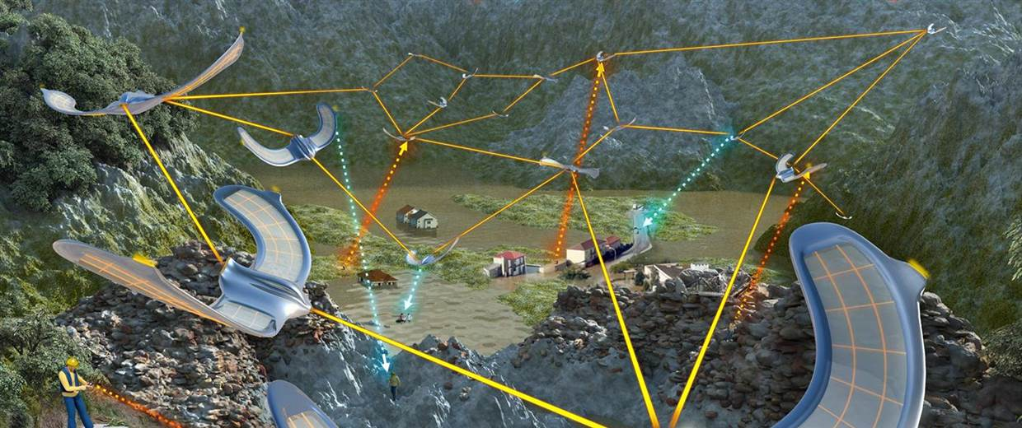
Story Line:
Before Disaster
During Disaster
After Disaster
State 3: Leaving Rain, Relieving Heart
阶段三 劫难过后：协力奋战，曙光初见
Legged Robots
1) Aerial robots and Snake robots be dispatched, navigating through the debris of collapsed buildings in search of signs of survivors.
2) Once survivors are found, it's time for the legged robots to shine. They nimbly traverse the ruins, carrying survivors out of danger or transporting supplies to support post-disaster reconstruction.
Space-earth Robots
3) These robots are not lone heroes but operate in swarms, as shown here, relying on an integrated space-earth robot swarm that shares information to greatly enhance the efficiency of disaster relief.

Slide 15
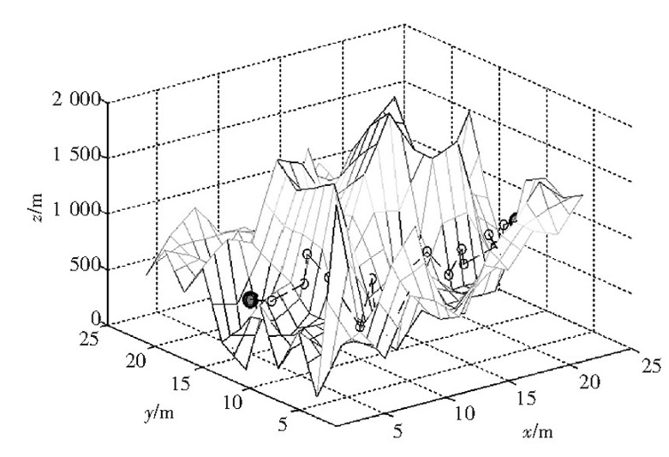
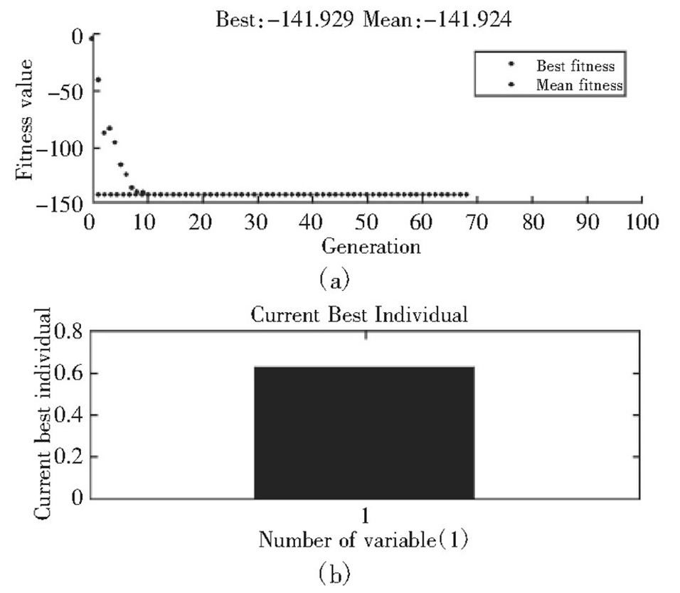
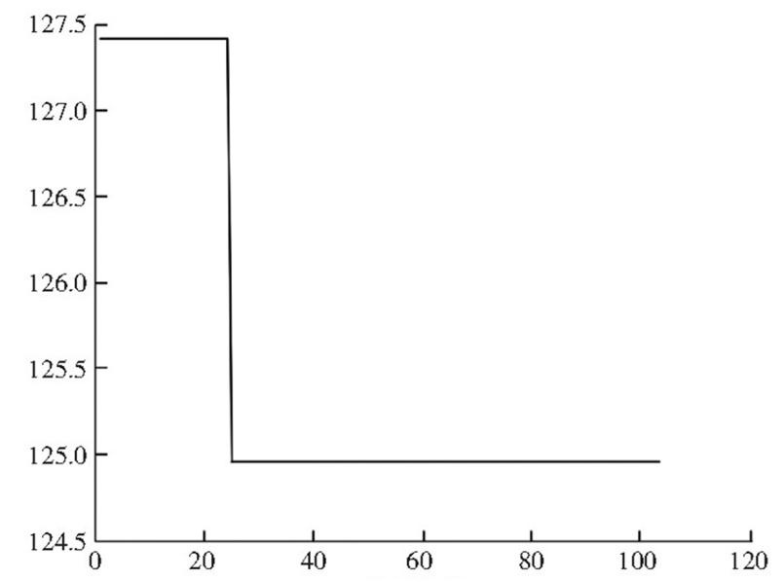
Question: How to control biomimetic robot system?
如何有条不紊地训练和控制机器人系统？
1) Genetic Algorithm (GA)
模仿生物“遗传”筛选出更合适的机器人
2) Ant Colony Optimization (ACO) 打造一个像蚁群一样相互配合的机器人集群

Slide 16
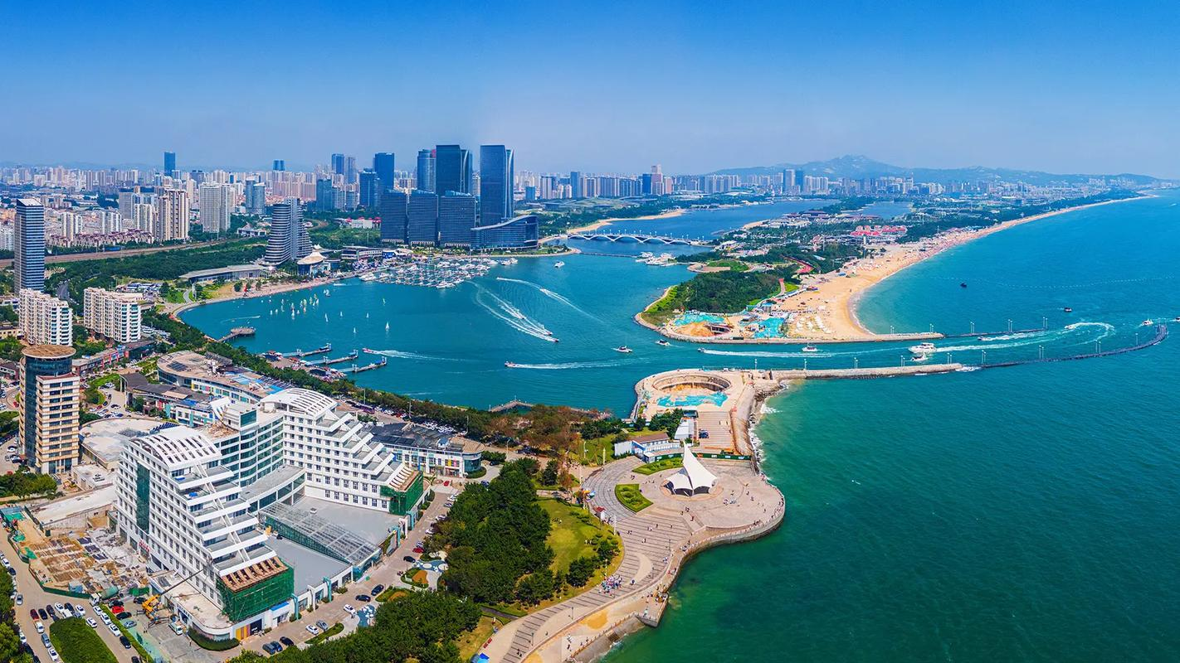
State 2: Finally We Won The Game!
阶段三 劫难过后：协力奋战，曙光初见
The Raccoon City successfully defended this disastrous typhoon, in a minimum economic loss, which manifested the huge power of technologies based on machine learning.

